Slide 1
Week 4 Presentation

Slide 2
Initial Attempt
Additive gaussian noise, standard deviation between 0.01 and 0.15 (small) to both real and imaginary parts
16000 training examples, between 0 (just noise) and 3 peaks
Trained bi-directional RNN with 3 layers followed by fully connected layer + sigmoid to make predictions
Training data labelled using peak bandwidth (not always accurate with multiple peaks) – is there a better way?
Problem: Large imbalance of ones and zeros in data – RNN simply predicts all zeros, large accuracy but not useful !
Accuracy not a useful metric for this problem

Slide 3
Attempt 2
Accuracy not a useful metric, use precision and recall instead
Precision = TP / (TP + FP), "Of all the instances that the model predicted as positive, how many are actually positive?"
Recall = TP / (TP + FN) , "Of all the actual positive instances, how many did the model correctly identify?"
Modified loss function to weight loss from ones higher than loss from zeros, wish to increase recall. Increased max num modes to 4.
~2h 30 training time (16000 training examples)
Epoch [150/150], Loss: 0.759, Precision: 0.608, Recall: 0.584, Validation Precision: 0.275, Validation Recall: 0.699

Slide 4
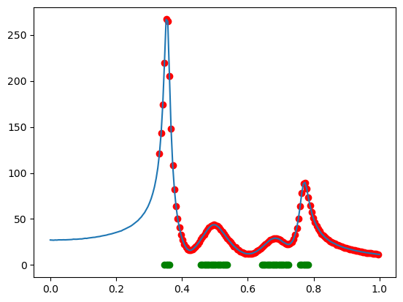
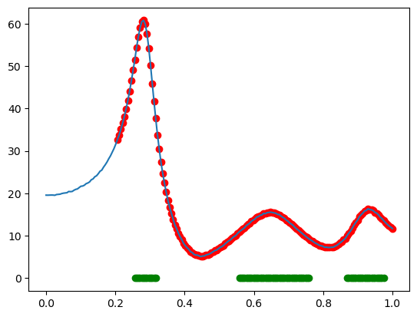
Now overpredicting ones!
Red = predictions, green = training labels for peaks

Slide 5
Attempt 3
Reduce weighting for ones in loss function to aim to reduce overpredictions
Switch from RNN to LSTM to see if there is any impact
50 fewer epochs, ~5h training time
Epoch [100/100], Loss: 0.326, Precision: 0.983, Recall: 0.696, Validation Precision: 0.976, Validation Recall: 0.694
Large increase in precision compared to before – no longer overpredicting ones

Slide 6
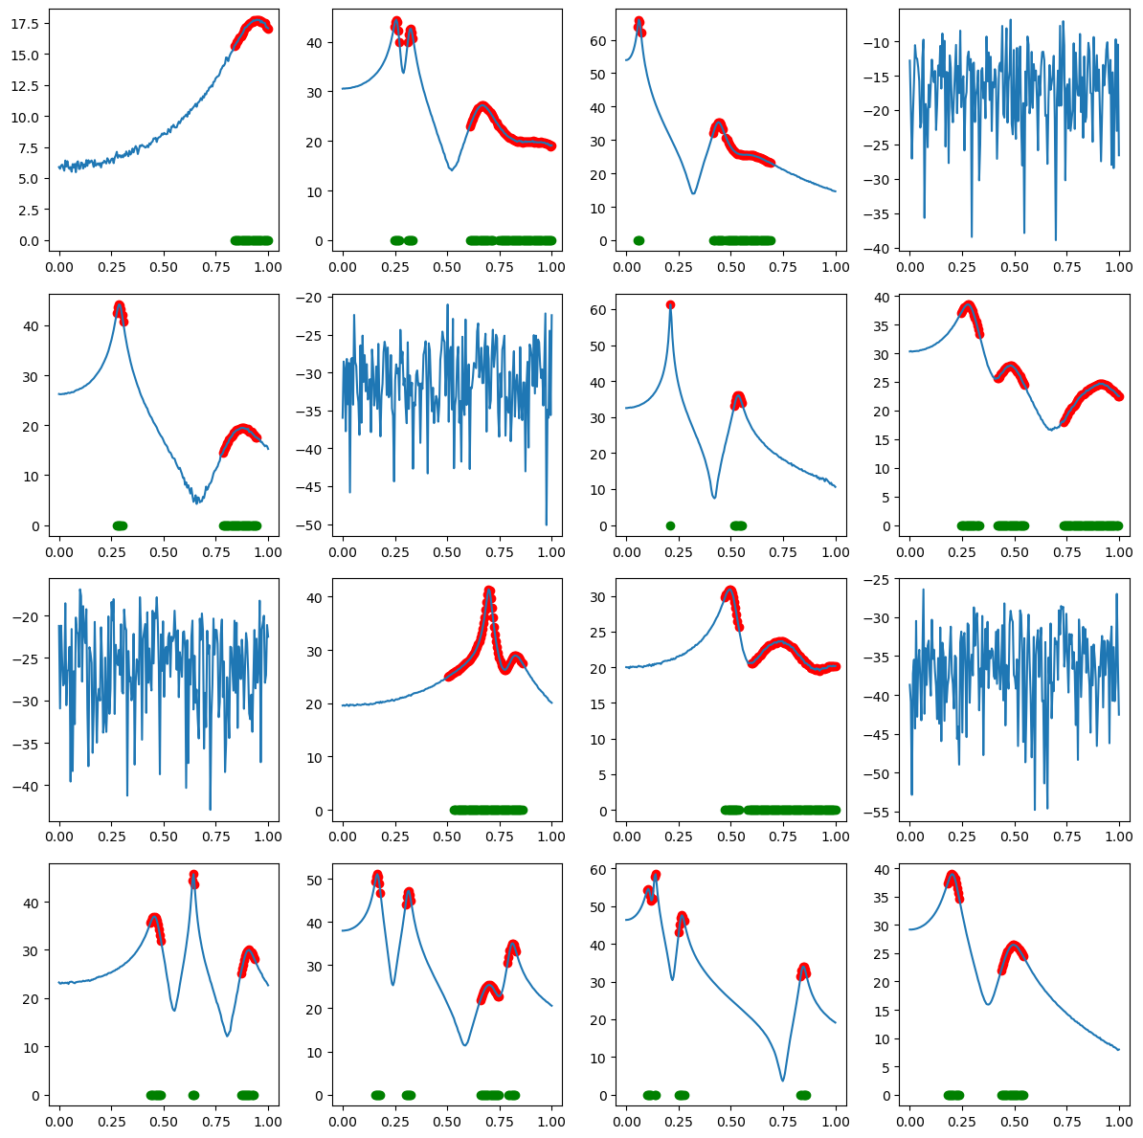

Slide 7
Next
More peaks, greater range of peak amplitude
More noise
Different sequence length input (look at how to interpolate)
CNN method?
Try on real experimental data
Increase training speed – better data normalization (method?)
Change hidden state size?
How to log work as I’m going?

